Slide 1
Toolkit
Johnny Gong, Xiaoxiao Jin, Sami Stegall

Slide 2
Division of Labor
We did the research and analysis of the topic we are going to study, the users as well as the settings together.
Johnny:
Sensitizing toolkit, cognitive toolkit, visual design, photography
Xiaoxiao:
Emotional toolkit, storyline toolkit, shopping
Sami:
Cognitive toolkit, shopping

Slide 3
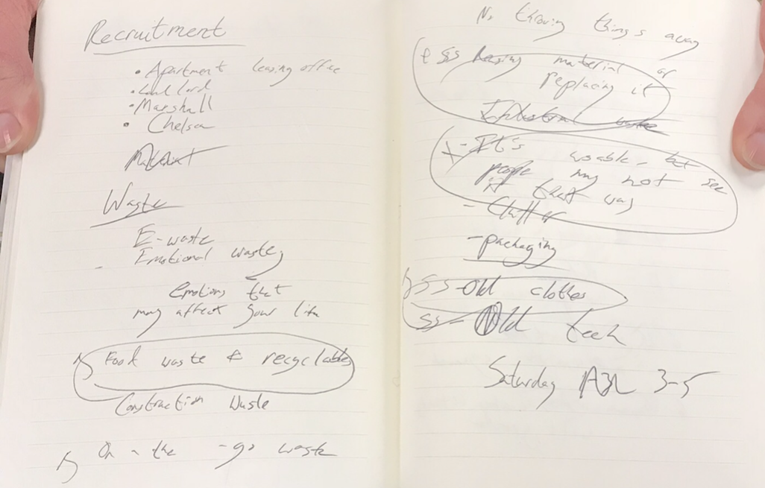
Research
We quickly put down the categories of what specific topics of waste management we’d like to investigate.
We finally voted for 3 categories:
Food waste
On the go waste
Resuables which are discarded
We are targeting the residents here in bloomington and also the leasing office of the apartment.

Slide 4
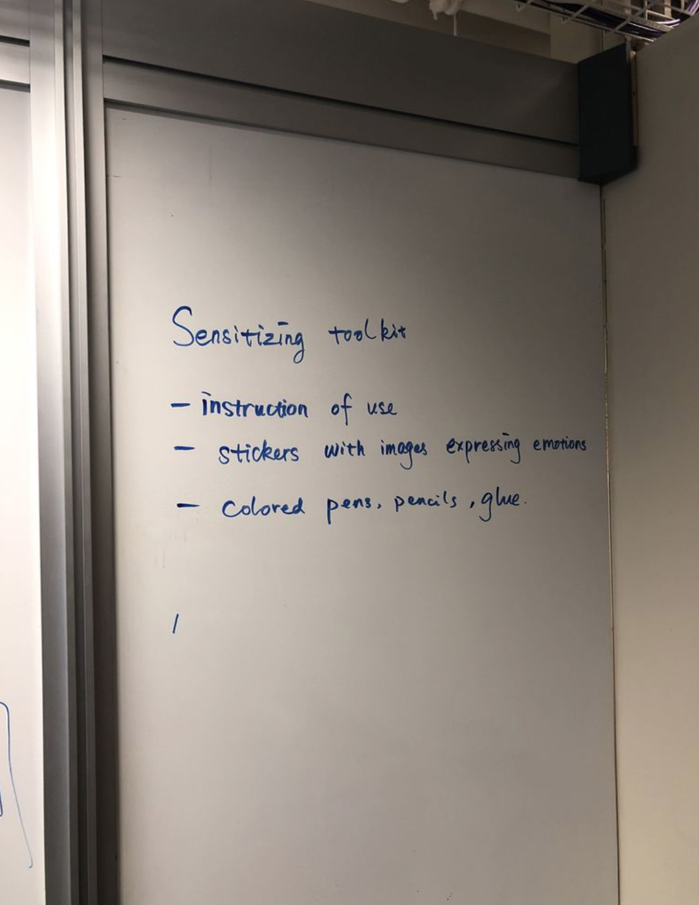
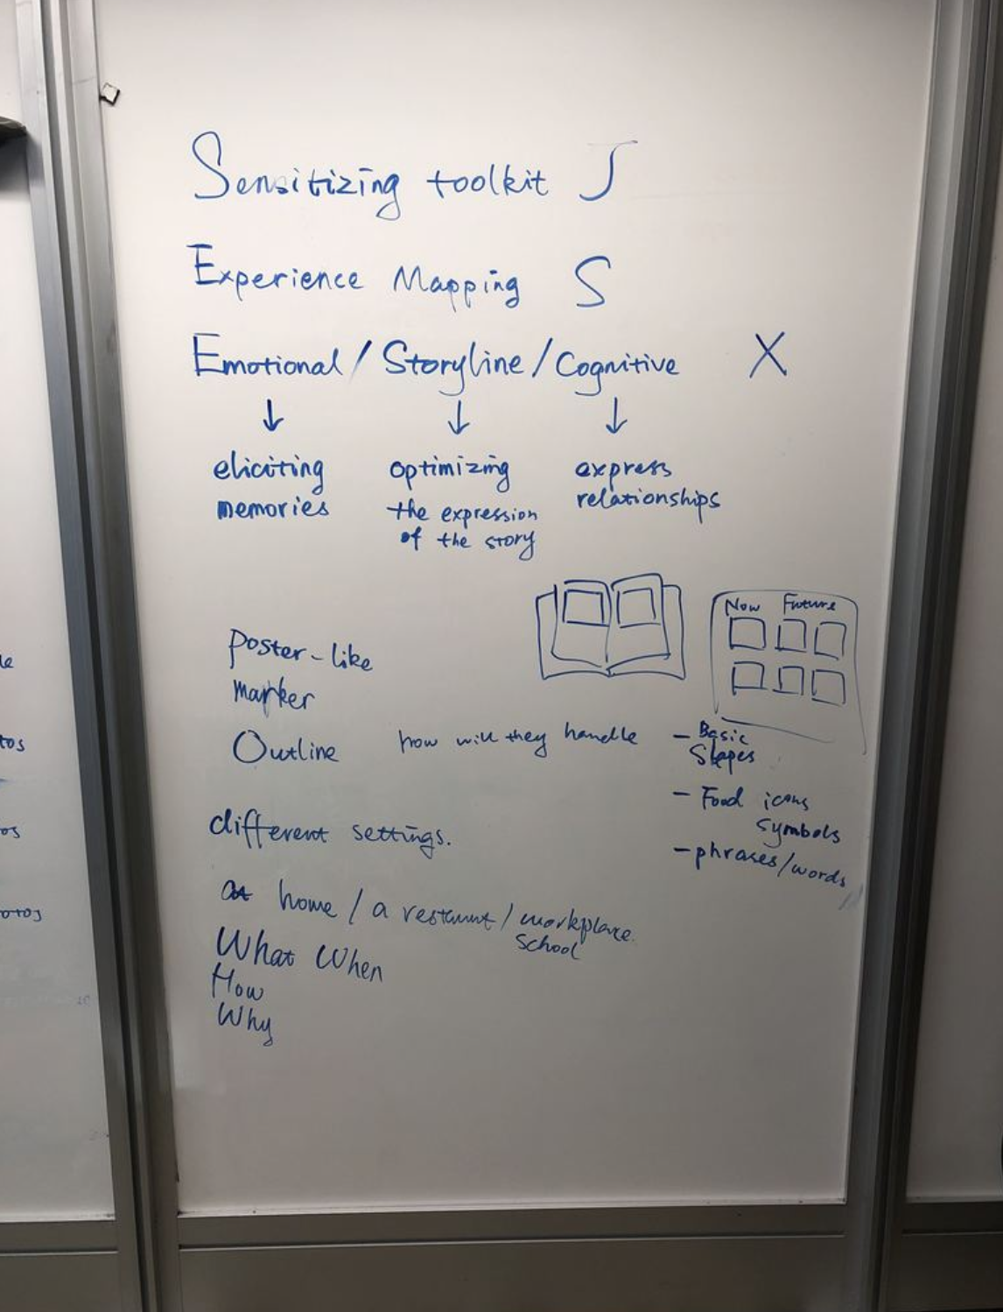
Sensitizing Toolkit
For people to sensitizing their experience of waste management (Focus: food waste). The toolkit then aims at letting people think of what kind of waste, how do they manage, why and when. The toolkit then is created out of either a spatial or temporal scale to let people map their experience.
We target how people manage their waste
at home
a restaurant
workplace/school
We target how people generate the waste and manage them later on a time scale.

Slide 5
Sensitizing Toolkit
Things we are going to include in our sensitizing toolkit:
Instruction
Paper of two settings (1. Blank to map the spatial experience. 2. One with a timeline to map the temporal experience)
Pencils & erasers
Pens
Color pencils
Highlighters
Post-it notes
Color papers
Scissors
Staplers/staples (for them to combine different maps if necessary)
Glue

Slide 6
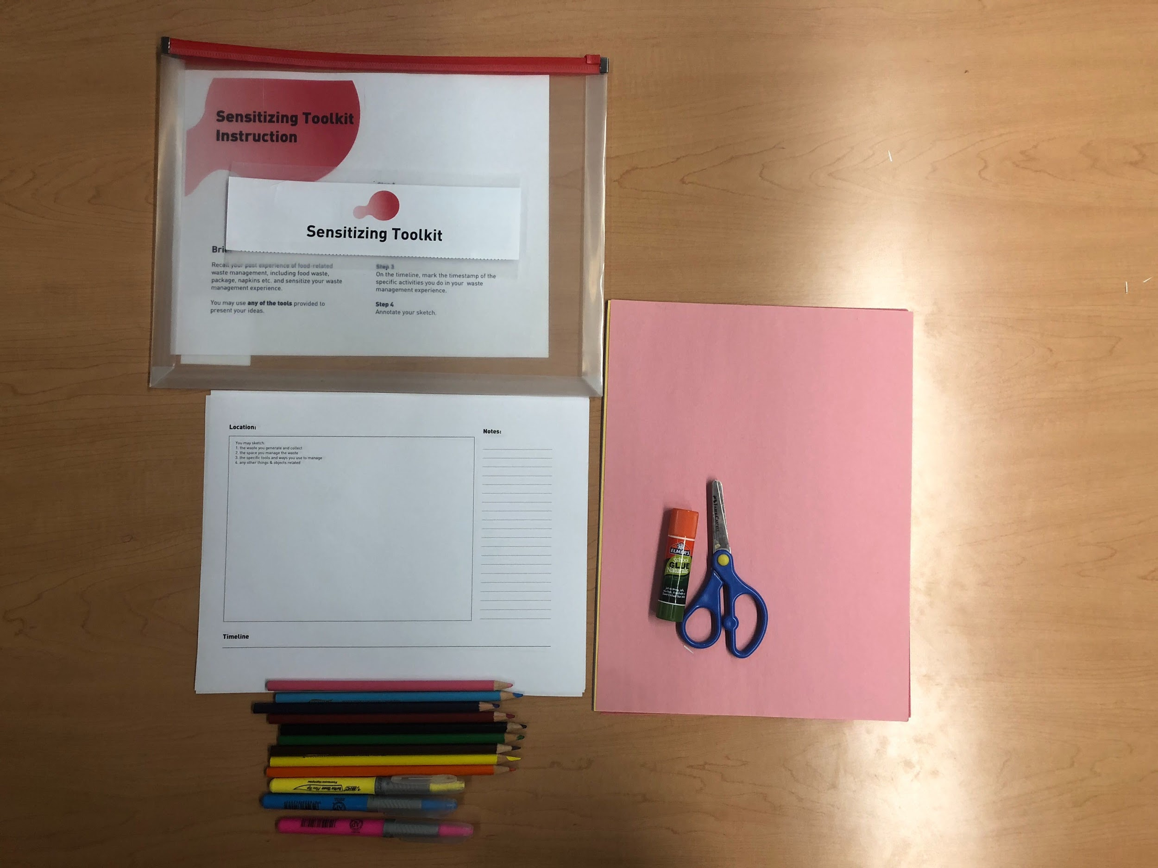
Sensitizing Toolkit

Slide 7
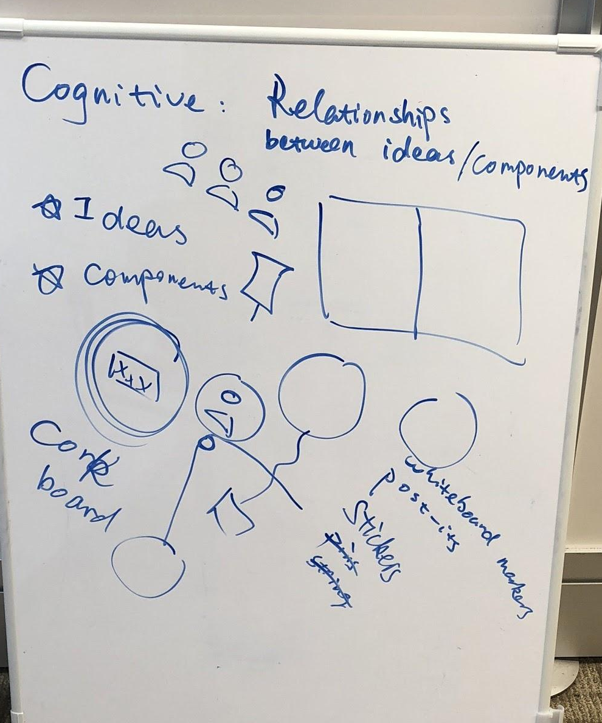
Cognitive Toolkit
Targeting interviewing the waste management in one of our apartments, we intend to see how the staff of leasing office map the relationship among the waste manage management service worker, residents and them.
Targeting interviewing how people manage their food waste at home/school/restaurant, we intend to see how they interact with different people in this process.

Slide 8
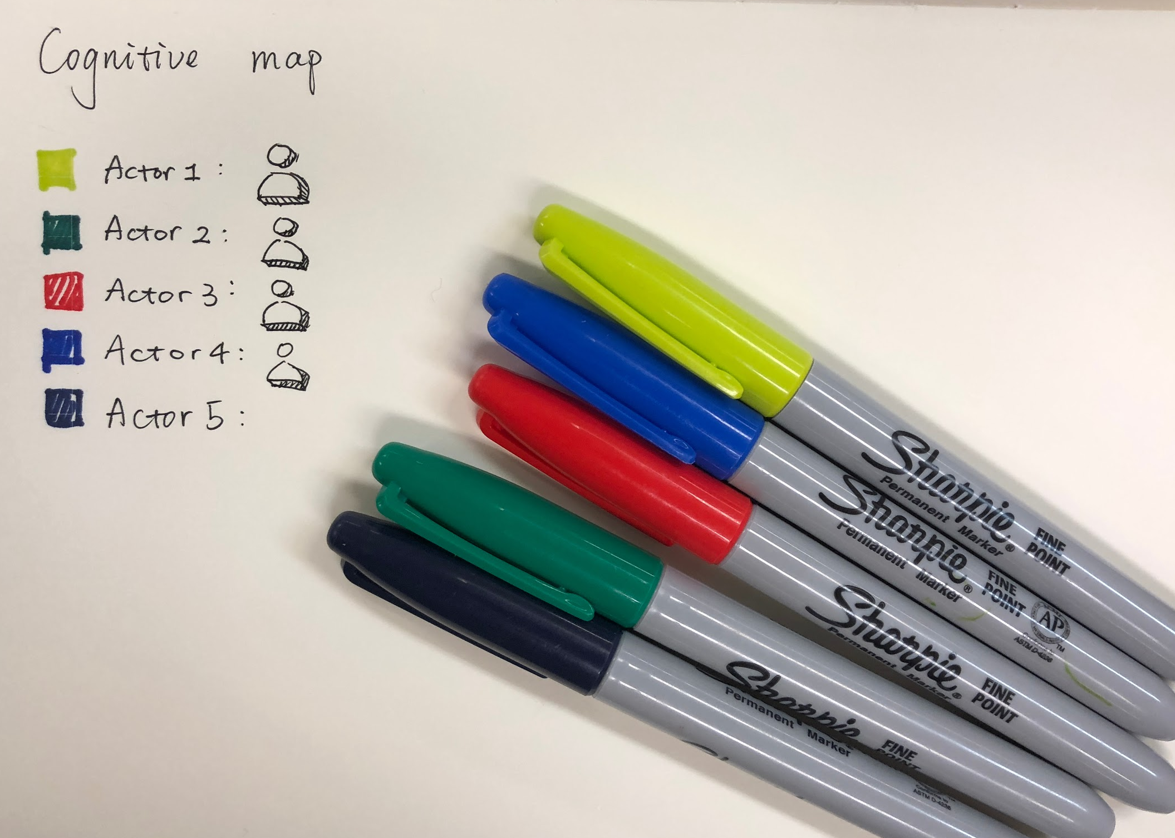
Cognitive Toolkit
Things we are going to include in our cognitive toolkit:
Blank paper with a legend of different colors representing different actors
Color pens/pencils
Pens
Badges/stickers representing different actors.
Post-it notes
Color papers
Scissors

Slide 9
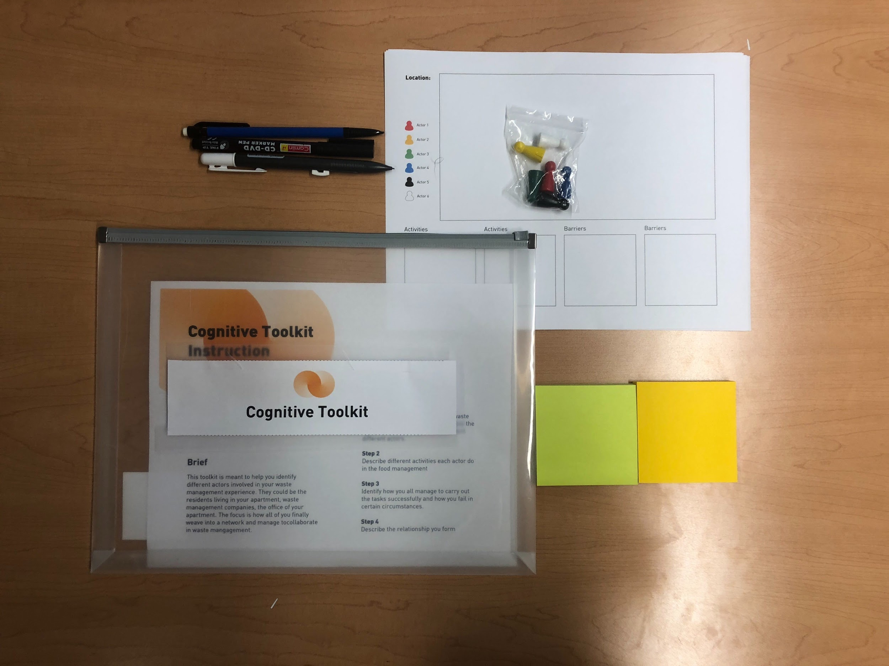
Cognitive
Toolkit

Slide 10
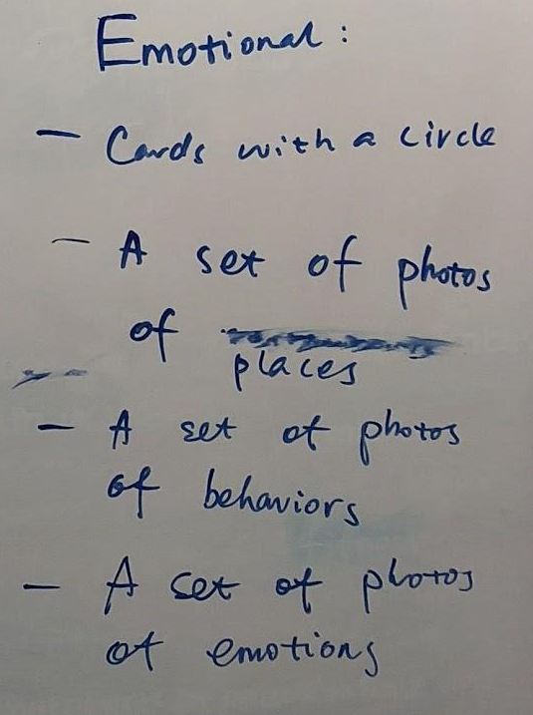
Emotional Toolkit
The goal of emotional toolkit is to elicit participants memories of the past waste management experience.
Our plan is to use a set of photos of places they might go and produce waste (e.g. restaurants, home, schools, workplaces), a set of photos to stand for their behaviors(e.g. throwing away trashes, recycling) and emoji stickers to help them relate specific feelings to places and behaviors.

Slide 11
Emotional Toolkit
Things we are going to include in our emotional toolkit:
Paper with photos of places
Emojis
Photo clips of behaviors
Glue
Pen to annotate

Slide 12
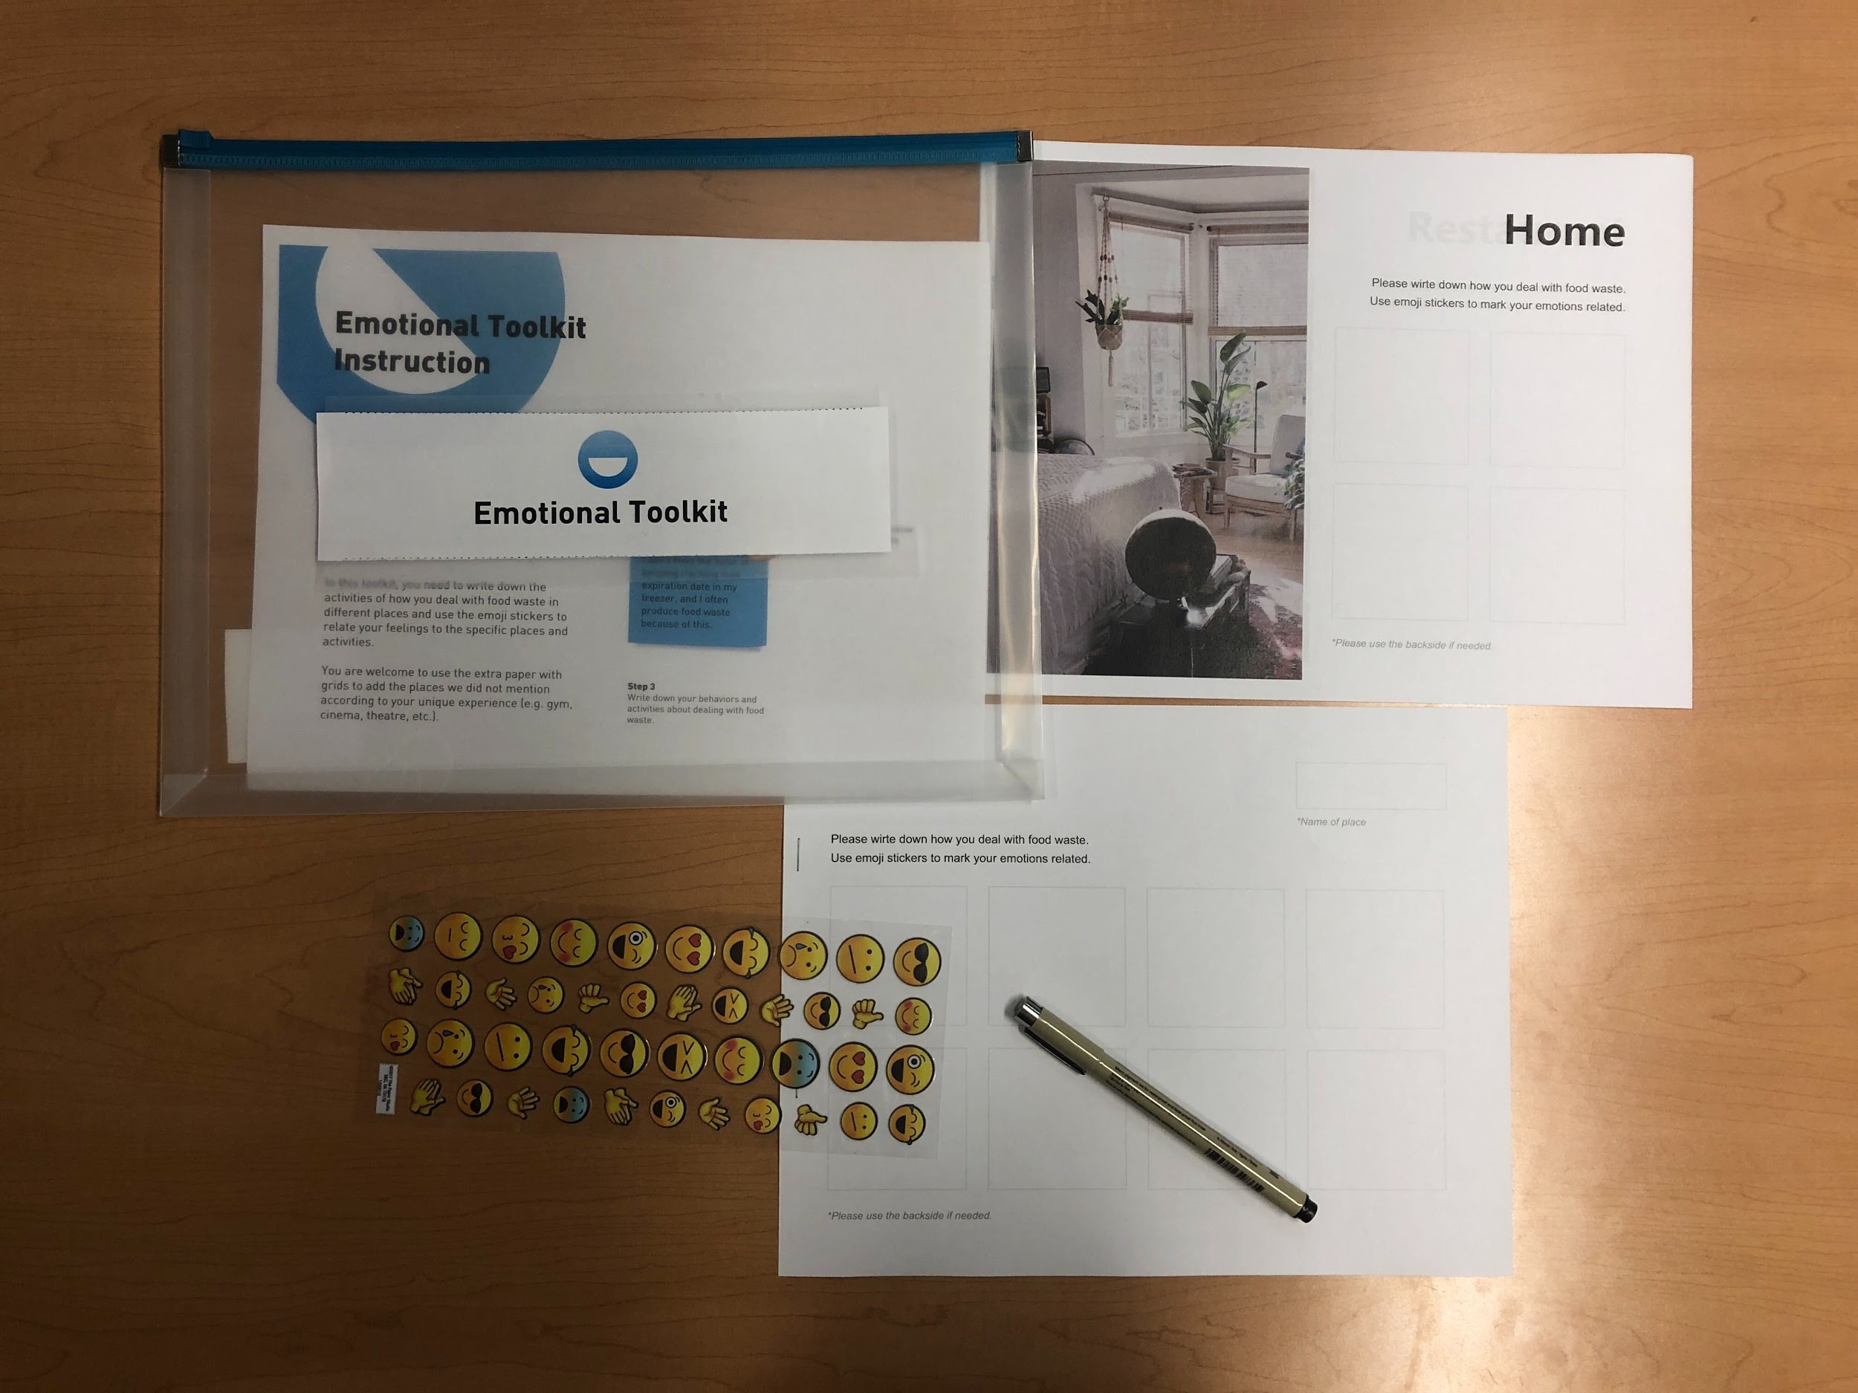
Emotional Toolkit

Slide 13
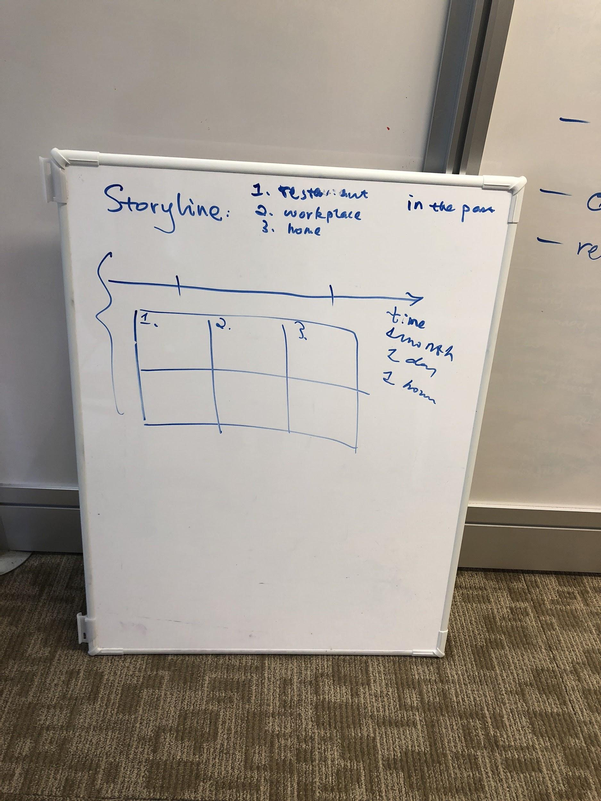
Storyline Toolkit
The goal for a storyline toolkit is to facilitate the expression of the story of waste management.
We developed two ways of implementation. Participants can choose either one they feel comfortable to represent their stories.
One way is to use a timeline running from left to right to stand for either a specific case (e.g. the overall process of one eating at a restaurant and dealing with food waste) or a longer period of time (e.g. how a person’s behavior and opinion changes with time). The other way is to give them a paper with grids and let them draw out their story to vividly show the behaviors and emotions at that moment.

Slide 14
Storyline Toolkit
Things we are going to include in our storyline toolkit:
Two types of paper with pre-printed line and grids
Pen
Color pencil & Eraser

Slide 15
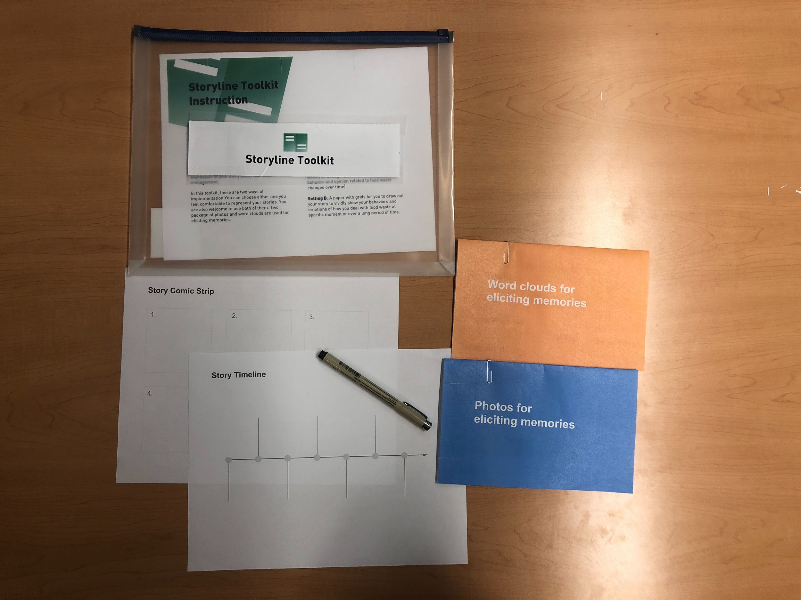
Storyline Toolkit

Slide 16
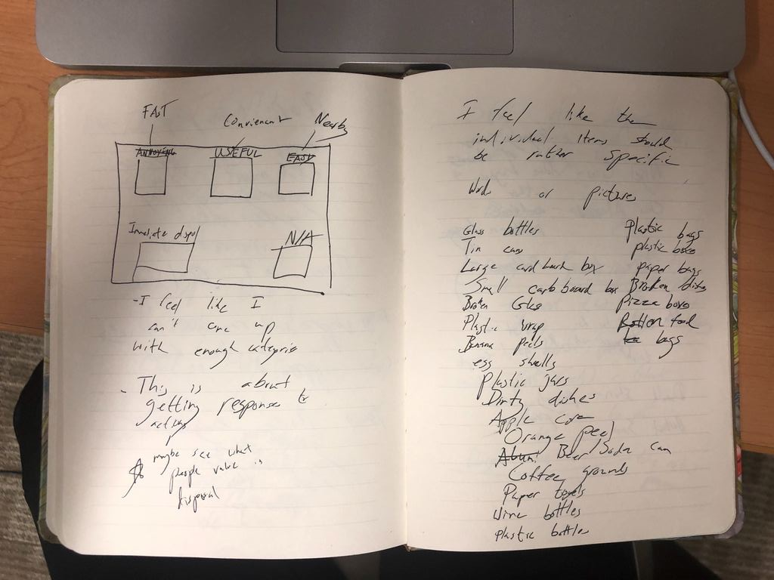
Experience Mapping Toolkit
We wanted our experience mapping toolkit to take inventory of what values guide people’s choices when dispose of food waste.
Participants will take inventory of how they dispose of food related waste by analyzing their habits based on unique items.
We the board we included has eight categories that participants can place certain items into

Slide 17
Experience Mapping Toolkit
Items we included in our experience mapping toolkit:
Paper board with eight divided sections
Paper strips that list individual waste items

Slide 18
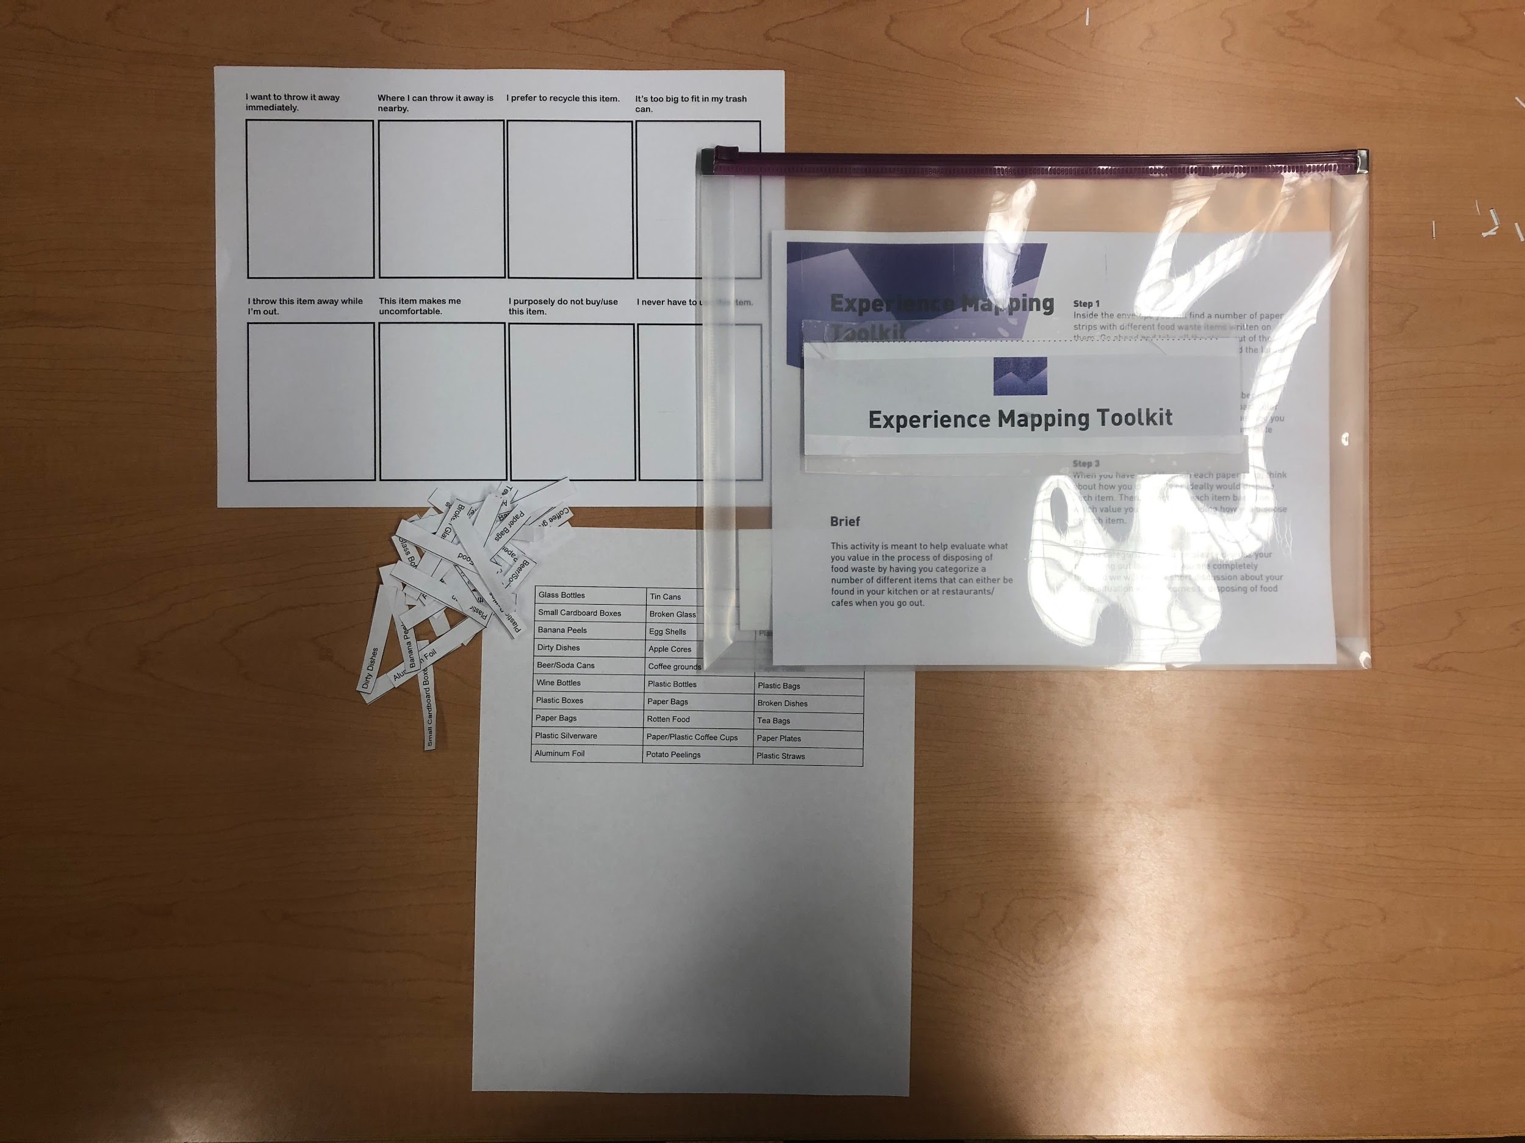
Experience
Mapping
Toolkit

Slide 19
Reflections
Overall, I am a bit apprehensive as to how this will work with users due to this method not being as open ended than the last few we used.
One theme that related the last three methods we used was that there were minimal instructions and the user was able to interpret the activity how they wanted. Granted, with these toolkits we literally wrote out provided instructions for the participant to follow which doesn’t allow them a lot of freedom to direct the conversation.
For the most part, I see this as a positive aspect of using toolkits. With the last interviews that I conducted with the mapping exercise and the what-if cards, I had to provide participants with a lot of guidance to get them to explain themselves further and gain something insightful from the activity. But, by laying out the activity in full before the participant starts it should be able to take place of me having to prod them to talk more.
One other concern I have ia whether or not the number of toolkits we have created will fatigue the participant during the activity. At some point in the research process, participants show signs that they don’t want to talk anymore, which means that it is time to end the interview. However, the user can’t really dictate when they want the activity to stop, so this could lead to them giving non-useful answers as it goes on.
I feel like I will be address these concerns for myself once we actually deploy the toolkit, but I am going to be thinking of them when preparing the experience.

Slide 20
Reflections
Breakdown:
The design of the toolkit: Compared to actually craft the toolkits the design of the is more challenging. It’s very hard of thinking how you use different toolkits to target what kind of questions.
How to communicate the use of the toolkit: At first I didn’t think of it in detail. I felt the we I talk about how to use it is very plain and dry.
Breakthrough:
The design of the toolkit: Viewing how other people design and craft the toolkit definitely gives us a clear plan. Reviewing the examples and think about how are we going to approach our user and thingking about the interview in detail facilitate the design.
How to communicate the use of the tookit: Talking to other classmates and discussing with my teammates shed light on this. The way Sami wrote the instruction is like talking to the user in person gentally, which inspired me a lot.

